Slide 1


Slide 2









-
-
-

Slide 3


Slide 4


Slide 5



Slide 6






Slide 7





Slide 9







-
-
-

Slide 10



-
-
-
-

Slide 12

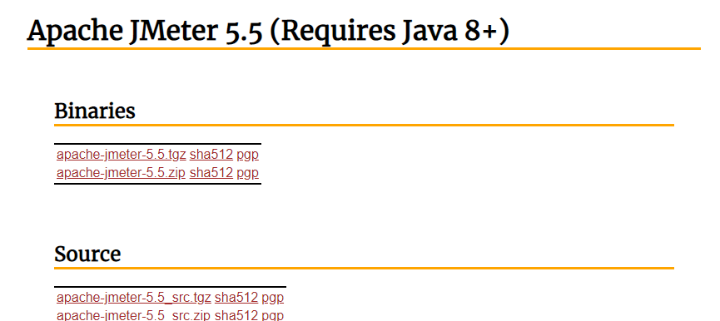

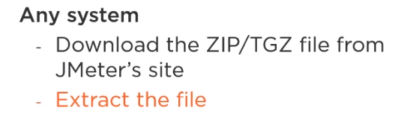

Slide 13

apache-jmeter-X.Y
|-- bin
|-- docs
|-- extras
|-- lib
|-- licenses
|-- printable_docs

Slide 14


Slide 15

jmeter.bat (for Windows)
jmeter (for Unix/Linux/Mac)

Slide 16



jmeter –n –t testFile.jmx
[-l resultfile.csv]
[-j logfile.log]
[-e –o outputFolder]

Slide 17
jmeter | –h | (for | help)
jmeter | -? | (for | command line | options)

Slide 18


Slide 19






Slide 20



-
-

Slide 21
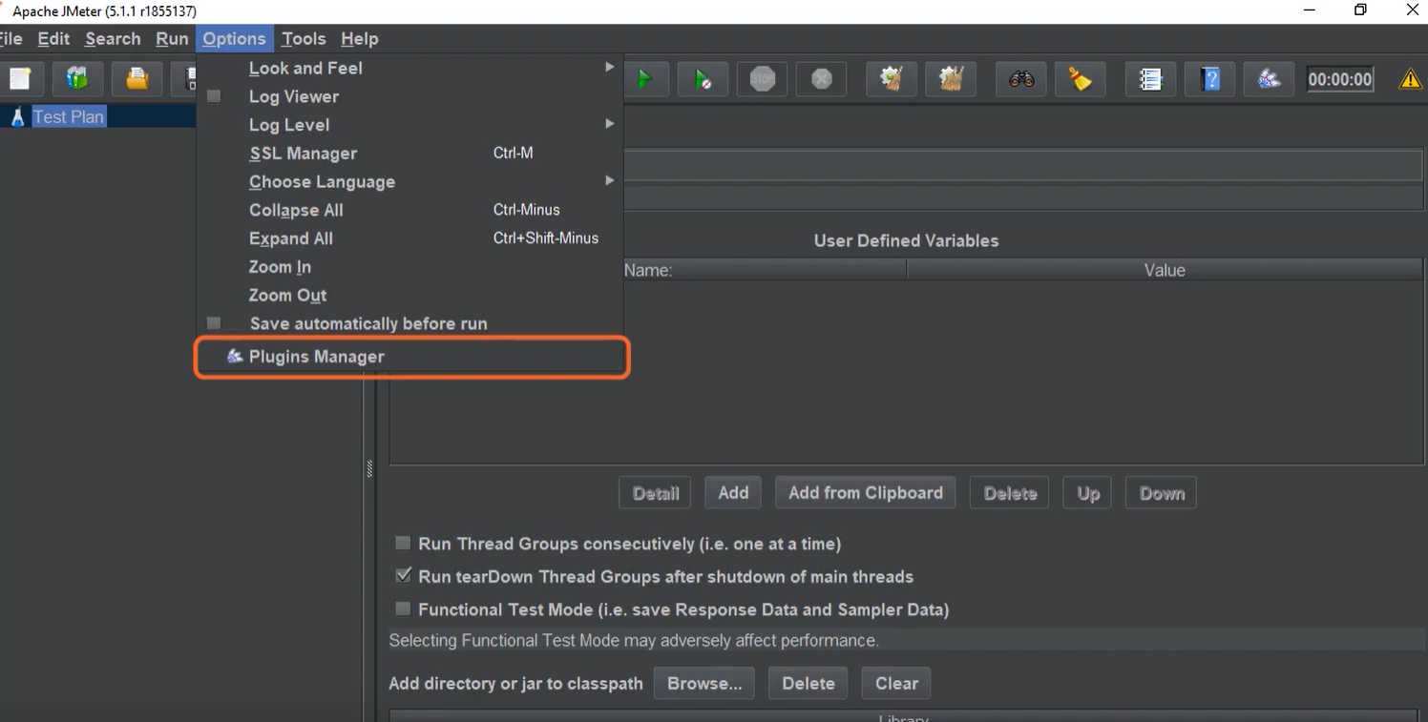

Slide 22





Slide 23




-

